Slide 1
Patient Satisfaction
Team Data Doctor

Slide 2
Problem
Dissatisfied Patients
Hospital:
Hospital Care Expenses/Costs: $500,000 to $850,000 annually per hospital at risk
Medicare reimbursement

Slide 3
Solutions
Improve patients’ healthcare experience
Drive recommendation rate up
Maximum Revenues and Smarter Spending

Slide 4
Values
Patient Satisfaction
Use of data
Revenue Streams: Greater inpatient use, higher overall health care, and prescription drug expenditures
Additional $2.2 million to $5.4 million annual revenue

Slide 5
Healtrics

Slide 6
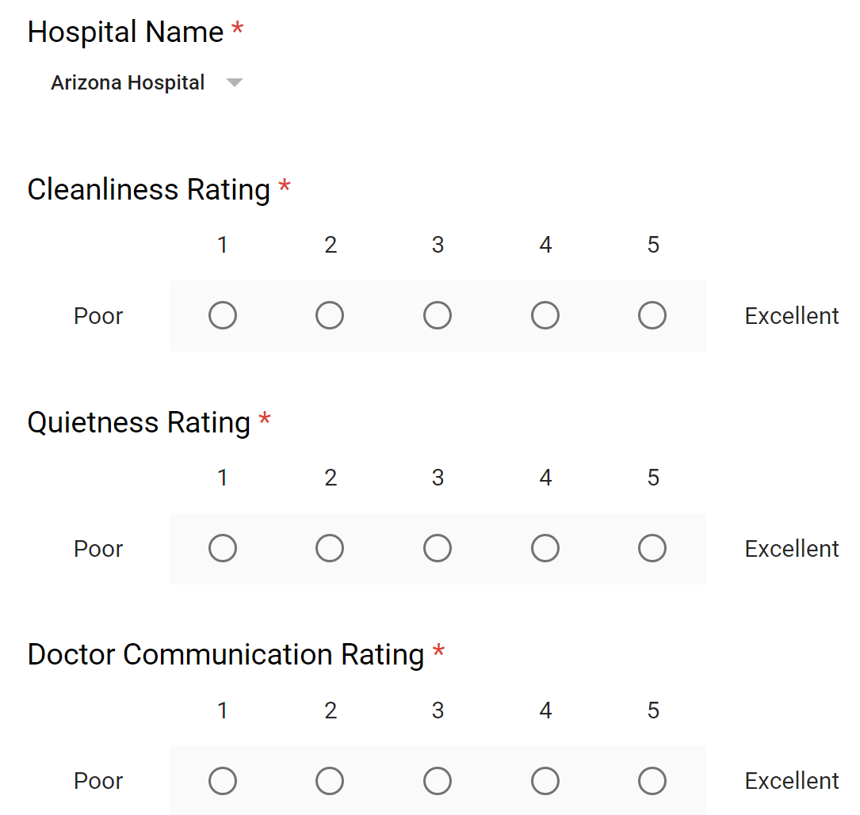
Product
How It Works
Staff Training

Slide 7
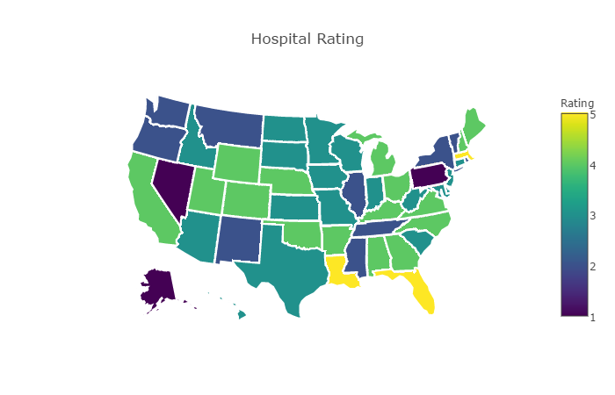
Channels
Target Market
Interaction with the data

Slide 8
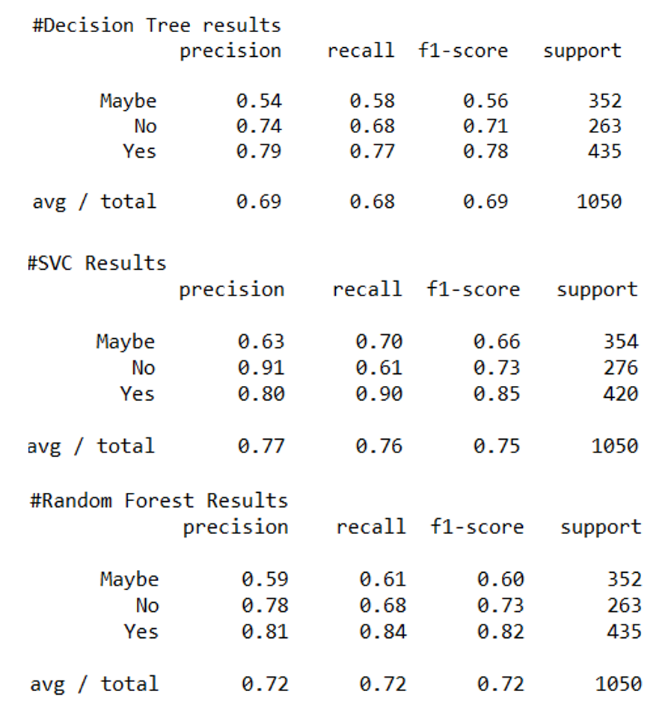
Competitive Advantages
Accuracy
Real-time
Generalizable
Scalable

Slide 9
Thank You! Q & A

